Slide 1
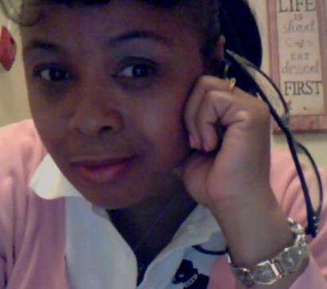
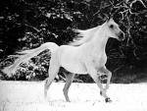
Mommies Don’t Live Forever

Slide 2
What is Elizabchlegaresingletonismn
A family member who is a catalyst to past domestic catastrophe then under the guise of ‘victim’ hinders the party or parties involved in those previous catastrophes ability to exercise their constitutional rights and/or poses and ongoing threat to the inalienable rights of the party or parties.

Slide 3
Why is Elizabchlegaresingletonismn a Detriment?
Elizabchlegaresingletonismn poses a threat to domestic tranquility and presents a foreseeable risk for further domestic catastrophe due to the elizabcher’s wonton disregard for the patterns of past catastrophic domestic events and hence continue to incite dysfunction with undue and unnecessary actions which threaten the liberty, freedom, mental and emotional well being of the elizabched (the one(s) acted against by the elizabcher).

Slide 4
Elizabchlegaresingletonastic theory of catastrophic reoccurrences
Elizabchlegaresingletonastic theory of catastrophic reoccurrences states that if two or more individuals who has a previous history of a shared catastrophic event in which the individuals were polar opposites in their social position, if they are ever again placed in one another’s realm of conscious existence another similar or dissimilar catastrophic event is likely to occur unless professional influences effect the personal constructs and behaviors of all of the individuals on each pole.

Slide 5
How
Elizabchlegaresingletonismn Effected One American Family
Before | After
Mother completely, selflessly, dotingly, involved in every aspects of these children’s existence | False unsubstantiated claims of maternal abandonment and lack of bonding by the elizabchlegaresingleton
Bio-mom had no prior juvenile or adult criminal police contact or involvement with child social services | Bio-mother incarcerated for attempted kidnapping of her two sons after child social services involvement as a result of elizabchlegaresingletonismn
Children had minimal risk for antisocial apathetic behaviors | Statistically significant increase for potential teen antisocial behaviors such as drug use/abuse, alcoholism, violence, delinquencies, identity crisis, emotional and relationship problems, incarceration, etc
Neither of these children’s parents had unwed teen pregnancies | Unwed teen pregnancy of the elizabchlegaresingleton (ELS) increase likelihood of the two teen boys it has been raising of becoming teen parents (source of info regarding ELS unwed teen pregnancy, The Late Reginald Terrence Singleton, MD <my babydaddy>)

Slide 6
How
Elizabchlegaresingletonismn Effected One American Family (con’t)
Before | After
Two mature adults working through marital strife one day at a time. Pledging never to go to bed angry with one another… and doing so | The narcissistic and dysfunctional skills of Elder and Matriarch ELS prevailed and annihilated her own son’s attempt at being a successful family man and taking pride in watching his family evolve through the years into what he and his wife (me) lifted up in prayer
Deidre and Reggie took the best of each of their families and contributed it to the family they were growing and leaving the worst of each of their families in the past. | elizabchlegaresingleton interjected its personal life long dysfunctional skills and insecurities into its son’s family causing irreparable dissolution of ANYTHING that was positive
Deidre is altruistic when it comes to matters of her family (husband included) she will fall on the cross and bear the burden of whatever is at stake, giving deference to those she love. The children’s lives were NOT subjected to living the same dysfunction as their maternal and paternal ancestors | As a result of elizabchlegaresingletonismn family dysfunction prevailed and these children are living stolen and altered lives. The elizabchlegaresingleton is selfish and in pursuit of its own creature comforts. It can NOT empathize with its prey putting itself in its grandsons’ reality and understanding what they may be feeling. This is a danger to their healthy emotional development
A stable secure future with the resources of both of their parents at their disposal ; a proverbial “leg-up’” in life | Not a damn-thang! from the successes of their parent’s professional and military careers is or has been available to contribute to their career choices as access to their parent’s guidance and support would have afforded them

Slide 7
Altruism or Elizabchlegaresingletonismn?
Calculate my household income if I would have just “gone with the flow” and took the path of least resistance accepting Reggie’s “course of divorce” and agreeing to take full custody of my two sons in 2001.
Calculate income lost by choosing passive resistance and trying to ‘save’ the sanctity of my family for the security and well-being of my two sons.
Calculate loss of property choosing intangible treasures (marriage, family, trust, security, etc) over worldly goods (money, property, title, position, etc)

Slide 8
Altruism or Elizabchlegaresingletonismn?
Calculate the household income of the elizabchlegaresingleton if she had not acquisitioned my two sons
Calculate the advantages, privileges, and blessings the elizabchlegaresingleton has enjoyed at these children’s expense by encouraging her late son to take the ‘low’ road regarding his family’s matters ultimately leading to his demise.
Calculate the odds of elizabchlegaresingletonismn prevailing

Slide 9
Food for Thought
I find it amazing (to the point of almost being asinine) that after that senseless shooting massacre in Newtown Connecticut that so much attention is given to changing the gun laws and design of weapons and their accessories but no one! As far as I know ever discussed the role the parents certainly have had in contributing to this disaster. This catastrophe was 20 years in the making. I believe in my legally untrained mind that the families of those 28 victims could surely wage a successful civil suit against the parents of that 20 year old young man. And I do not mean just the mom because she had (like a bonafide jackass) all those lethal weapons around a person who with any level of average intelligence and human sensitivities would have anger issues as a result of the wrecked state of their family unit.
My legal perceptions and intellect on a scale of 1-5 is about a 0.5 yet I can clearly see that changing the guns and gun laws is not the most significant effort that could be made on affecting heinous acts such as the aforementioned; however, it is indeed the most ‘comfortable’ effort to be made. These new fangled social norms that are acceptable and contribute to adult pleasures and the happiness we seek profoundly and exponentially contribute to the remorse, sadness, and emotional instability of our youth. But instead of enacting laws and imposing penalties on those who behave badly (especially when they have families…and just as children know when they are behaving badly so does adults) it’s easier for the leaders to simply blame the inanimate objects and require changes to them as opposed to requiring changes of themselves and their constituents (We the People).
My baby-daddy (the late Reginald Terrence Singleton, M.D) has two sons that are presently caught up in a wacky world of elizabchlegaresingletonization that could if not affected by the good and stable citizens of their community in Aiken, SC who can empathize with their situation could potentially be on a course to apathetic sociopathic behaviors that will land them in our penal system or as in the Newton Connecticut disturbance the pain that my sons’ family’s dysfunction has caused them over the years can spill over into their Aiken community affecting not just their lives but the lives of many. Their paternal grandmother who is raising them is likely an undiagnosed narcissistic psychopath and she cannot empathize with their losses; therefore she cannot relate to what their emotional and psychological needs may be as it relates to getting closure and asking questions of their maternal family, the family which they have been taken from based on the lying wagging tongue of one elizabeth legare singleton.

Slide 10
Contemplations
My contemplations consisted of what changes in the laws (gun laws, family laws, personal injury laws, etc) that could be made to circumvent this sort of event in the future; I considered the family history from which the shooter came and all the dynamics that could have contributed to the young man’s state of mind (as this tragedy was 20 years in the making). The victim count by police officers from a legal perspective may be 26 but from a social and public health perspective the count is 28 (the 20-year old shooter and his 24-year old brother; the brother seemingly at this time not involved in the crime but surely a victim of the family dynamics that failed their expectations);

Slide 11
Life, Liberty, Freedom and the Pursuit of Happiness for Self and that of Our Posterity.
The rhetoric is aimed at changing laws to ‘keep guns out of the hands of ‘dangerous people’; the fact is we are all ‘dangerous’ given the right combination of circumstances. Without changing laws to distinguish between the two types of victims, the innocent ones like those at the Elementary school. Shoppers in a mall, Diners at a restaurant, Drivers on the highway, etc from persons who contribute to their own victimization then we as a civil society are doing little to provide alternatives to person who feel they must act to affect their own life, liberty, freedom and pursuit of happiness for themselves and that of their posterity. People that ‘poke bears’ and then become a victim of that bear when the bears is fed up with the poking should NOT stand under the same "victims banner" with the same protections as innocent victims (those who are victimized but did not incite the bear).These aforementioned areas are indeed inequalities that are built into the structure of our society through patterns of acceptable new fangled social norms that while contributing to adult pleasures and the happiness adults seek profoundly and exponentially contribute to the remorse, sadness, challenges, and emotional instability of our youth.

Slide 12
Be Inspired and Enthused at Changing Our Own Behaviors
When the decision to go shopping at the mall instead of shopping online, or dining out at a restaurant with friends and family instead of eating in, or the decision to take in a movie at a local theatre instead of pay per view or DVD at home becomes a life or death decision time-and-time again without any predictability or way of avoidance then it is time to take a close look at all aspects of the situation to determine what can be done and not just hastily involve ourselves in ‘knee-jerk’ responses to exact changes on inanimate objects or rally to effect laws and policies that do not affect us personally but effect others in significant ways. For instance, there is a big push to ban assault weapons, decrease the number of rounds in magazine clips, require background checks for all gun purchases, and prohibit the mentally ill from purchasing guns. Those changes will affect some people, mostly gun enthusiast therefore; the majority of people calling for these changes are not affected. As a leader my vision would be to inspire people to look at themselves and recognize what they can do, what role can they play in affecting the social norms that create apathy toward violence or the need to use violence to resolve personal or social matters. I would encourage us to be as inspired and enthused at changing our own behaviors as we are in changing the behaviors or activities of others.

Slide 13
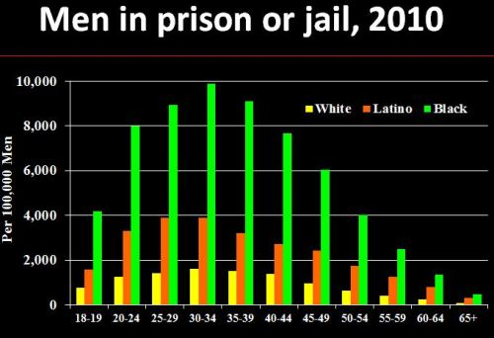
Two Young men's Futures Hangs in the Balance…They Should Know they Were NOT Abandoned

Slide 14
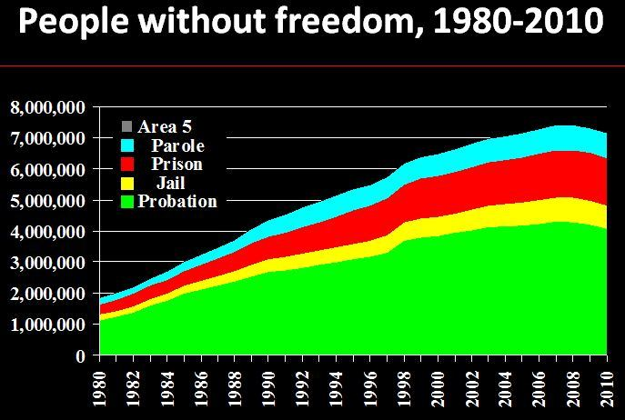
Reginald and Terrence Mott Singleton Should Know Their Family History Before They Become Victims of the System

Slide 15
References
“Men in Prison or Jail, 2010” and “People without Freedom, 1980-2010” graphs courtesy of

